Slide 1
Resilient Communities in Myanmar
Dr. Mike Griffiths @ Dr. Aung Naing
Research Consultant, SPPRG

Slide 2
Why is resilience an important concept?
1. Growth and development can be undermined by risk, threat and crisis.
e.g. climate change, economic crisis, health crisis
2. Risks, threats and crisis are constantly changing
3. Systems which generate or mitigate risk are increasingly complex and inter-connected.

Slide 3
Definition and Key words
The ability of groups or communities to cope with external stresses and disturbances as a result of social, political, and environmental change
Absorbing
Adapting
Acting to change

Slide 4
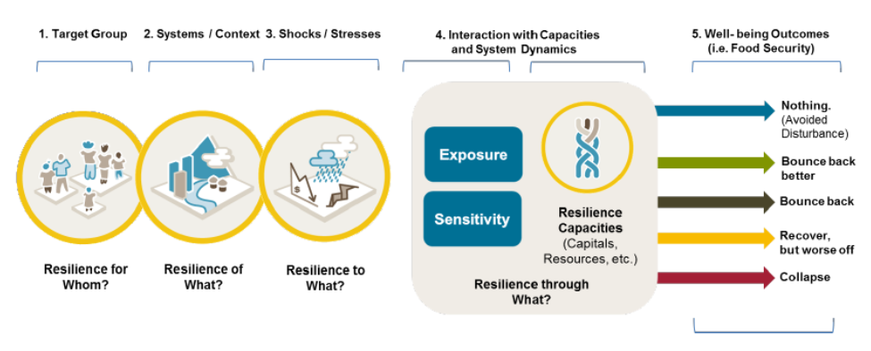

Slide 5
How does resilience work?
Resilience is characterized by actions which enable a person or system to cope with stress, to return to normality after the impact of stress, to adapt to be better able to cope with stress in the future, and to deal with the cause of the stress.
This requires two things:
Agency = willingness and capacity to act
Opportunity = enabling environment in which to act
strengthening capacity x enabling environment = adaptation and empowerment = resilience

Slide 6
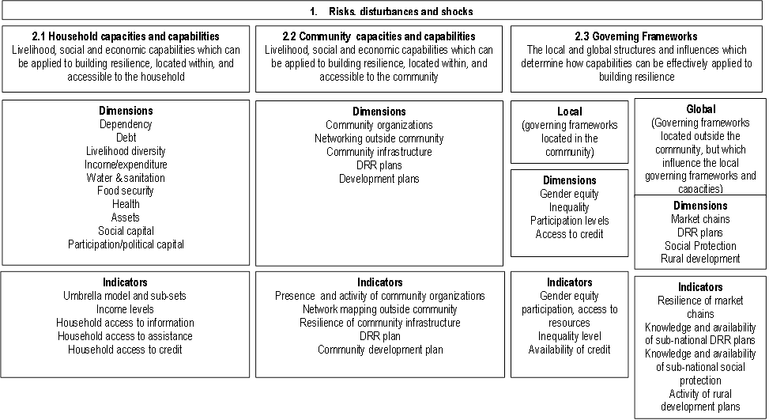

Slide 7
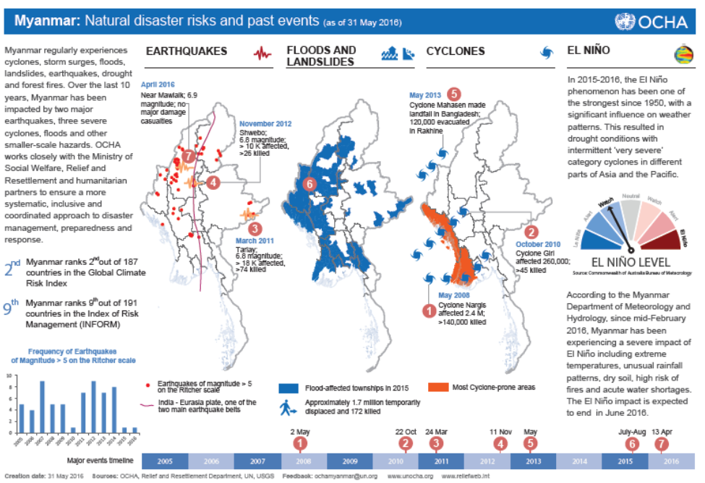
Risks, hazards, threats

Slide 8
Type of Community | Unsustainable Debt | Market fluctuation | Natural disaster and climate change | Unstable markets | Low price of produce due to climate change
Fishing | 27.0% | 17.2% | 14.7% | 11.3% | 13.0%
Uplands Agricultural | 15.4% | 8.2% | 3.5% | 2.5% | 8.0%
Dry Zone Agricultural | 14.7% | 8.6% | 9.2% | 2.0% | 13.2%
Coastal and Delta Agricultural | 14.9% | 7.0% | 4.4% | 1.3% | 3.8%

Slide 9
What does resilience look like at household level?
Patterns of behaviour which we would normally associated with resilient households.
Actions which contribute to the strengthening of the household economy (such as investing in livelihoods or savings-called investive behaviour)
Actions which weaken the household economy (such as taking high interest loans for consumption-called erosive behaviour).
By mapping the balance of these types of behaviour in a household, we can make an estimate of their resilience.

Slide 10
State/Region | % HH with Consumptive Loan | % HH with livelihood investment | % HH with savings (any)
NPT | 11.8% | 57.8% | 19.6%
Kachin | 10.2% | 56.5% | 9.3%
Kayah | 11.7% | 83.3% | 10.0%
Kayin | 17.7% | 46.2% | 5.2%
Chin | 34.3% | 4.9% | 0.0%
Sagaing | 17.3% | 67.6% | 18.5%
Tanintharyi | 29.5% | 68.8% | 10.2%
Bago | 11.7% | 63.9% | 23.5%
Magwe | 16.4% | 47.4% | 13.4%
Mandalay | 12.6% | 71.3% | 22.8%
Mon | 19.1% | 31.8% | 31.5%
Rakhine | 26.7% | 29.6% | 4.4%
Yangon | 12.0% | 46.7% | 16.1%
Shan (S) | 6.7% | 58.4% | 16.9%
Shan (N) | 5.5% | 77.6% | 22.4%
Shan (E) | 0.8% | 2.5% | 0.3%
Ayearwaddy | 13.5% | 44.9% | 17.7%
Union | 13.3% | 53.3% | 17.8%

Slide 11
What factors are associated with higher levels of resilience?
National & Sub-national factors:
Factor | Effect | Strength of Association
Poverty (state & Regional level) | High poverty, low resilience | +++
Inequality (distribution of wealth) | High inequality, low resilience | +++
Income inequality | High inequality, low resilience | +++
Development status (infrastructure) | Low development, low resilience | +
Village size | No effect | N

Slide 12
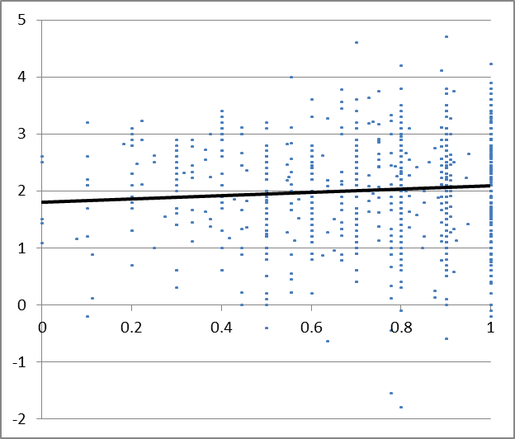
What factors are associated with resilience at community level?
Governance

Slide 13
What factors are associated with resilience at community level?
2. Presence of community social organization
 | Villages with social organization | Villages without social organization
Average household resilience | 2.1 | 1.98
Percentage classified as low-resilience | 18.5% | 20%
Average resilience of poor households | 1.91 | 1.81
Percentage of poor households classified as low-resilience | 22% | 24%

Slide 14
What factors are associated with resilience at community level?
3. Gender equity
Active participation by women in village affairs and equal wages associated with higher levels of resilience, particularly amongst poor households

Slide 15
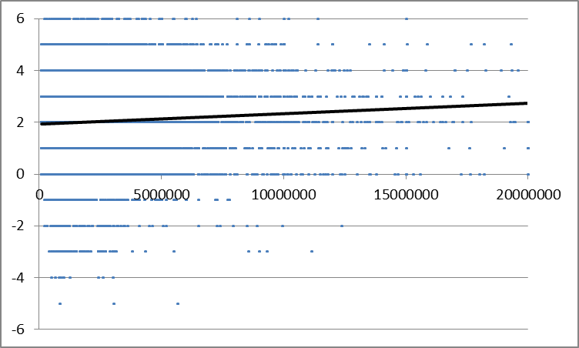
What factors are associated with resilience at household level?
Income

Slide 16
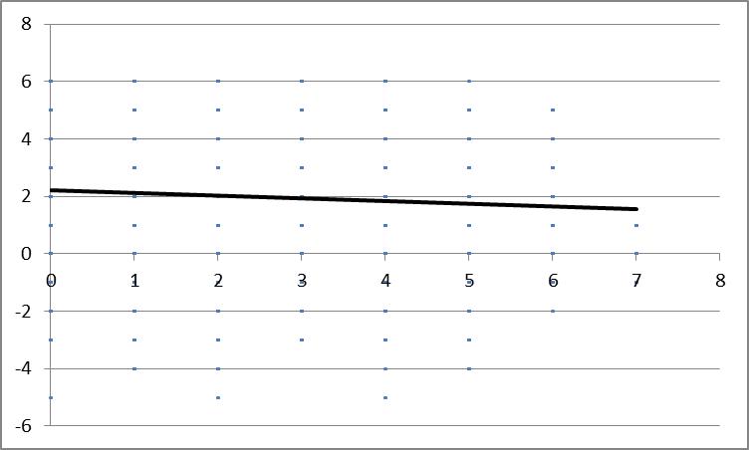
What factors are associated with resilience at household level?
2. Vulnerability

Slide 17
What factors are associated with resilience at household level?
3. Food security
 | Households without food insecurity issues | Households which have experienced food insecurity in previous 12 months
Average household resilience | 2.05 | 1.49
Percentage classified as low-resilience | 16% | 30%

Slide 18
Towards more resilient communities
Pro-poor policies which reduce inequalities
Integrated approaches to rural (and urban) development
Strengthening of community organizations
Targeted interventions to increase incomes
Interventions to address specific vulnerabilities (individual, household and communities)

